Slide 1
Cohort Analysis & Segmentation with RFM
By: Asmaa Aamer

Slide 2

Cohort analysis is a kind of behavioral analytics that breaks the data in a data set into related groups before analysis. These groups, or cohorts, usually share common characteristics or experiences within a defined time-span.

Slide 3
Returned users over subsequent months
Cohort Month |  | Month 0 | Month 1 | Month 2 | Month 3 | Month 4 | Month 5 | Month 6 | Month 7 | Month 8 | Month 9 | Month 10 | Month 11
 | Jan | 573 | 38 | 31 | 39 | 29 | 25 | 12 | 27 | 24 | 27 | 11 | 5
 | Feb | 682 | 35 | 26 | 22 | 15 | 14 | 11 | 13 | 20 | 19 | 3
 | Mar | 751 | 24 | 16 | 11 | 9 | 14 | 16 | 15 | 18 | 8
 | Apr | 727 | 27 | 25 | 15 | 17 | 18 | 14 | 17 | 13
 | May | 666 | 14 | 15 | 11 | 23 | 36 | 9 | 10
 | Jun | 617 | 17 | 19 | 4 | 11 | 14 | 7
 | Jul | 709 | 15 | 15 | 17 | 17 | 6
 | Aug | 755 | 16 | 25 | 27 | 4
 | Sep | 712 | 20 | 15 | 10
 | Oct | 747 | 26 | 5 | 1
 | Nov | 800 | 12
 | Dec | 843

Slide 4
% of Returned users over subsequent months
Cohort Month |  | Month 0 | Month 1 | Month 2 | Month 3 | Month 4 | Month 5 | Month 6 | Month 7 | Month 8 | Month 9 | Month 10 | Month 11
 | Jan | 100.00% | 6.63% | 5.41% | 6.81% | 5.06% | 4.36% | 2.09% | 4.71% | 4.19% | 4.71% | 1.92% | 0.87%
 | Feb | 100.00% | 5.13% | 3.81% | 3.23% | 2.20% | 2.05% | 1.61% | 1.91% | 2.93% | 2.79% | 0.44%
 | Mar | 100.00% | 3.20% | 2.13% | 1.46% | 1.20% | 1.86% | 2.13% | 2.00% | 2.40% | 1.07%
 | Apr | 100.00% | 3.71% | 3.44% | 2.06% | 2.34% | 2.48% | 1.93% | 2.34% | 1.79%
 | May | 100.00% | 2.10% | 2.25% | 1.65% | 3.45% | 5.41% | 1.35% | 1.50%
 | Jun | 100.00% | 2.76% | 3.08% | 0.65% | 1.78% | 2.27% | 1.13%
 | Jul | 100.00% | 2.12% | 2.12% | 2.40% | 2.40% | 0.85%
 | Aug | 100.00% | 2.12% | 3.31% | 3.58% | 0.53%
 | Sep | 100.00% | 2.81% | 2.11% | 1.40%
 | Oct | 100.00% | 3.48% | 0.67% | 0.13%
 | Nov | 100.00% | 1.50%
 | Dec | 100.00%

Slide 5
In general, the retention rate is so low under 10%.
Customers in Jan was 573 after one month returned just 38 and after 3 months returned 39 and then the retention started to decrease, and so on for the remained months.
Cohort Analysis Insights

Slide 6
RFM Analysis
RFM stands for segmenting your customer base on Recency, Frequency, and Monetary behavior took together.
Recency – How recently did the customer purchased or did the desired event?
Frequency – How often do they purchase or do the desired event?
Monetary – How much do they spend / monetary value of the desired event?

Slide 7
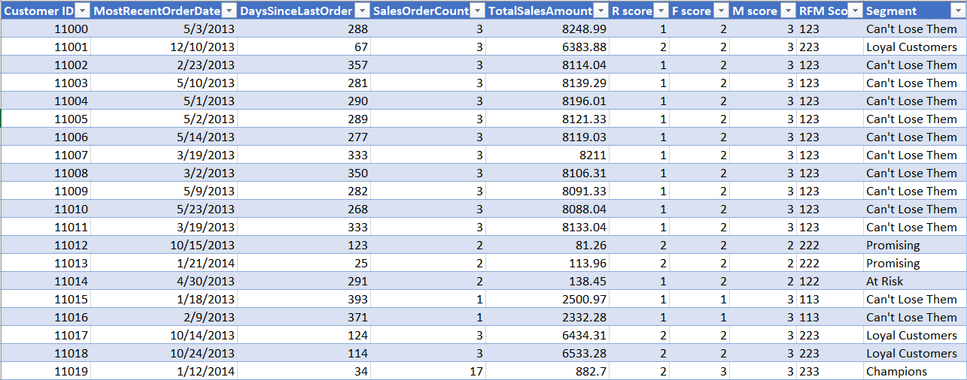
RFM DATA

Slide 8
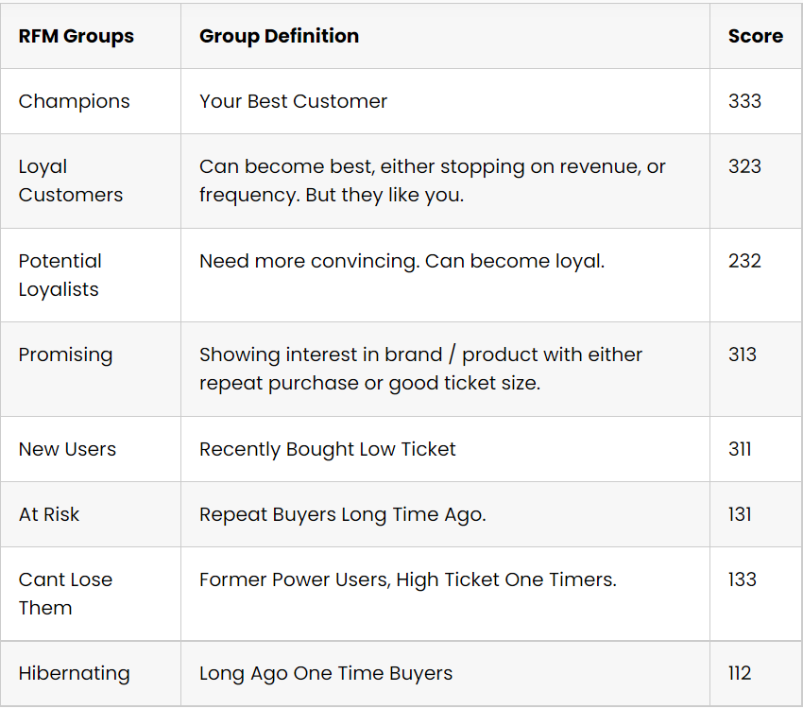
RFM Groups and Their Definition

Slide 9
Count of Customers in each Segment
At Risk | 459
Can't Lose Them | 4724
Champions | 35
Hibernating | 4060
Loyal Customers | 2694
New Users | 5
Potenial Loyalists | 14
Promising | 6493

Slide 10
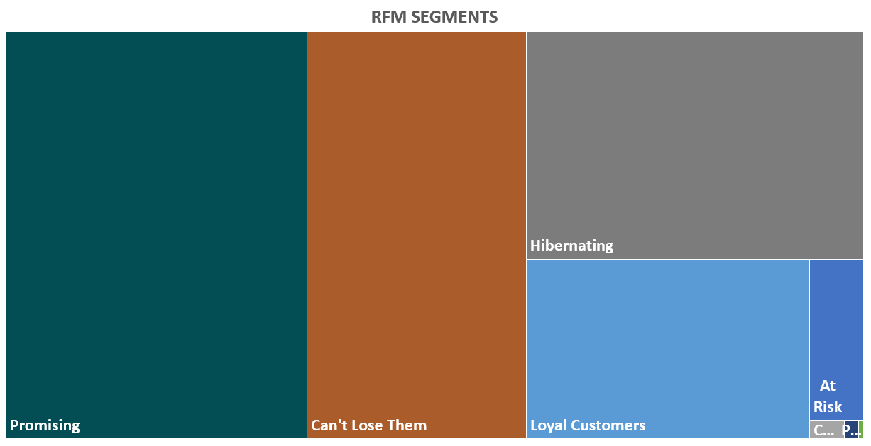

Slide 11
Promising Segment has the highest number of customers (6493), They Purchased from us recently and paid good amount of money, but with low quantity of items.
Can’t lose them Segment has the second highest number of customers (4724), They haven’t purchased from us for a long time, but they pay great amount of money and more quantity of items that’s why we can't lose them.
Champions are our best customers, but they are so few (35).
Insights on RFM Analysis

Slide 12
RFM Actionable Analysis
(The next step)
1. Acquire :
More customer like our best customers and loyal customers.
2. Reward :
Best and Loyal customers for their loyalty.
3. Monetize :
Potential loyalist and promising customers.
4. Retain :
New customers and promising customers.
5. Reactivate :
At Risk, Hibernating, Can’t Lose Them customers.

